Slide 1
Computer Networks Switching
Configuration

Slide 2
Cisco Packet Tracer
Cisco Packet Tracer is a network simulation tool developed by Cisco Systems. It is designed for students, educators, and professionals to simulate network configurations, troubleshoot network problems, and experiment with network behavior in a virtual environment. Packet Tracer allows users to create network topologies, configure routers, switches, and other networking devices, and observe how data packets flow through the network. It supports various networking technologies and protocols commonly used in Cisco networking environments, providing a hands-on learning experience for networking concepts and skills.

Slide 3
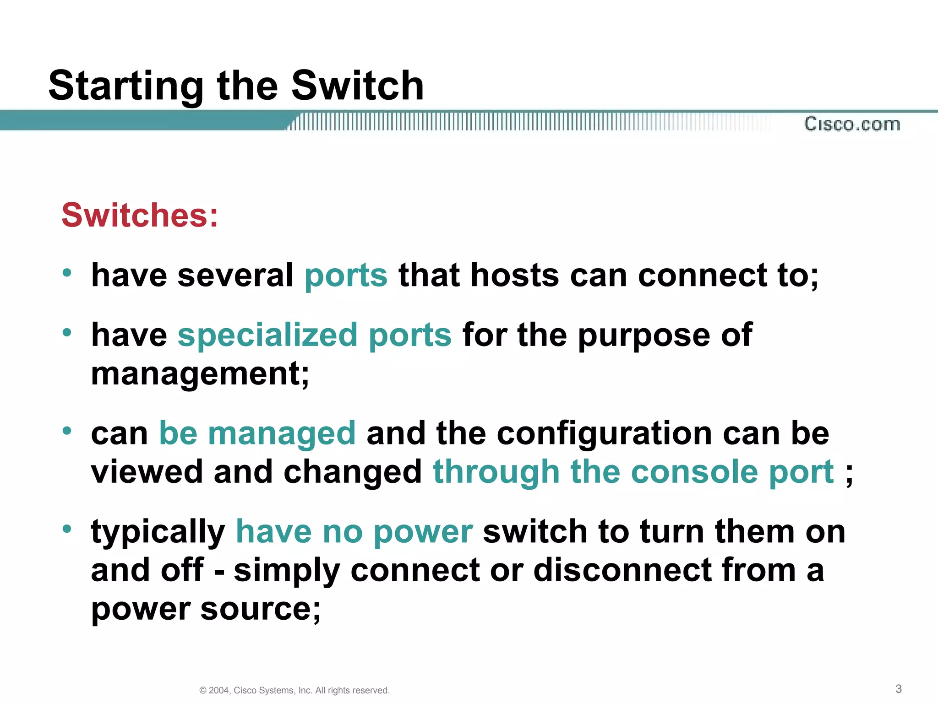
Switch configuration

Slide 4
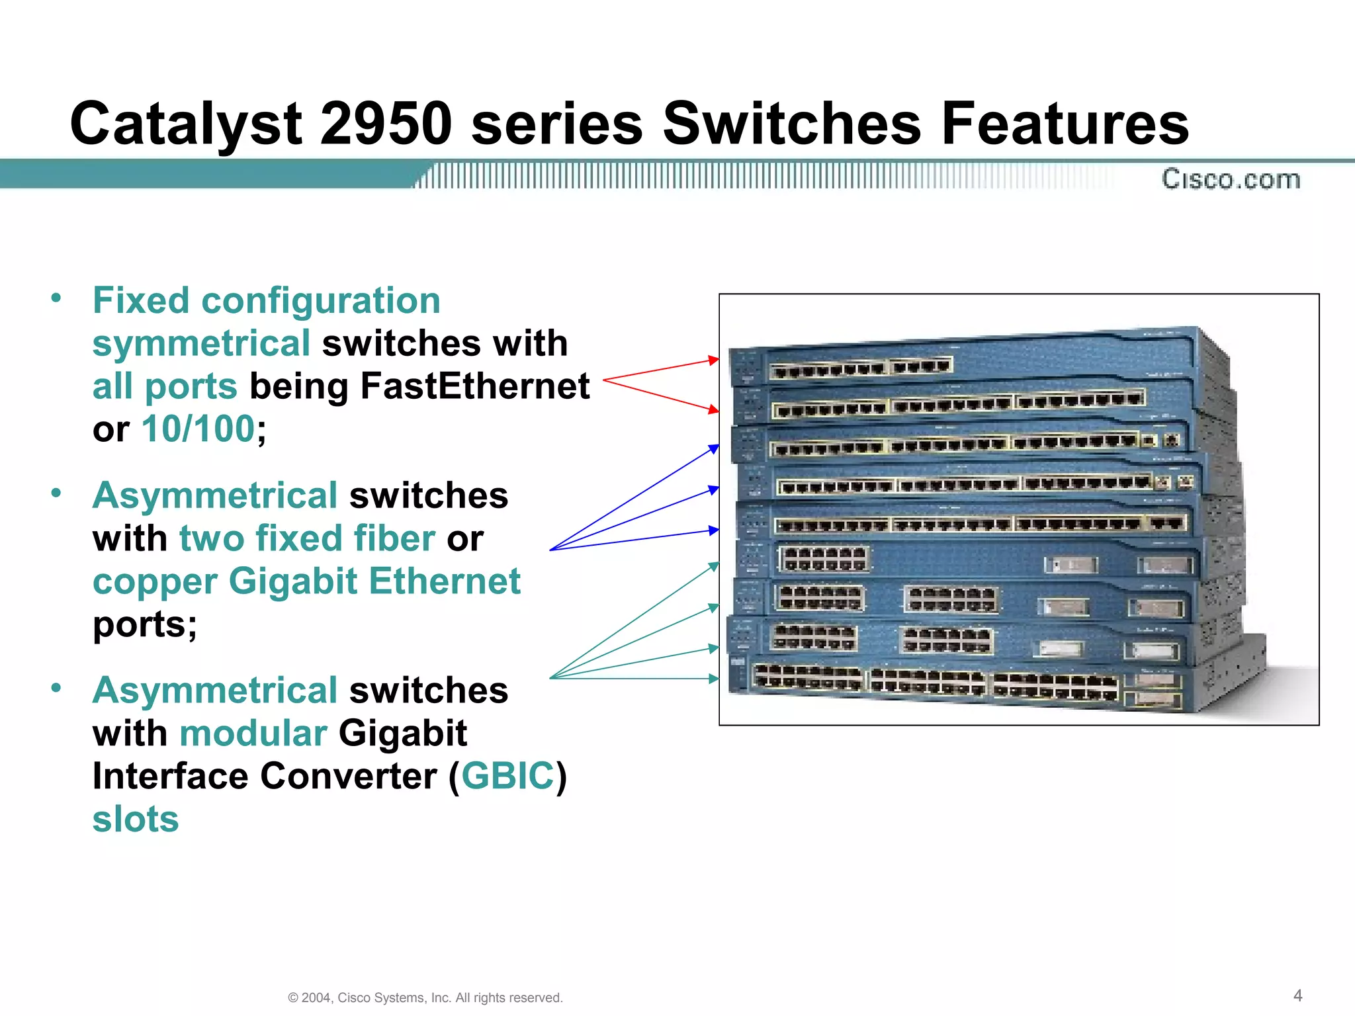

Slide 5
Symmetrical switches treat signals traveling in both directions equally, asymmetrical switches are tailored to optimize performance or meet specific requirements for signals flowing in a particular direction.

Slide 6
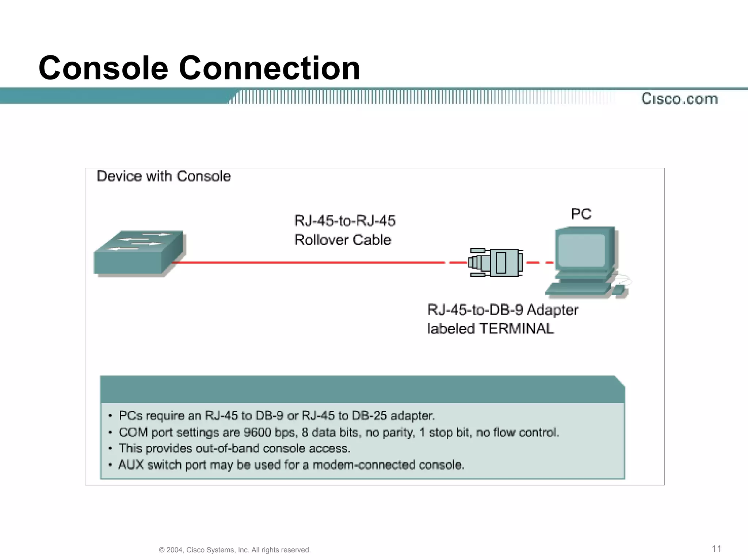
Connecting switch to PC

Slide 7
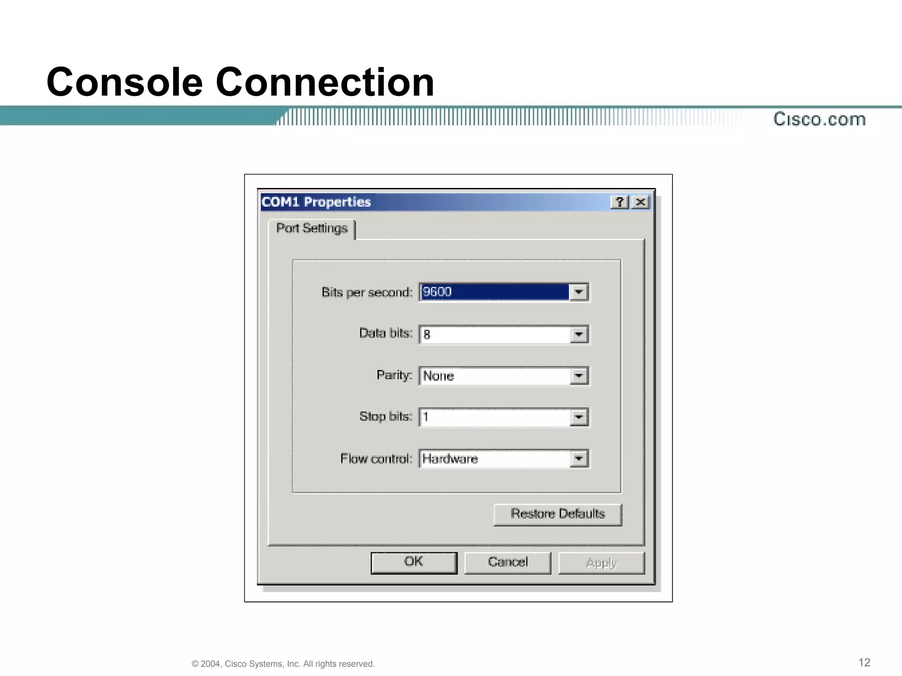

Slide 8
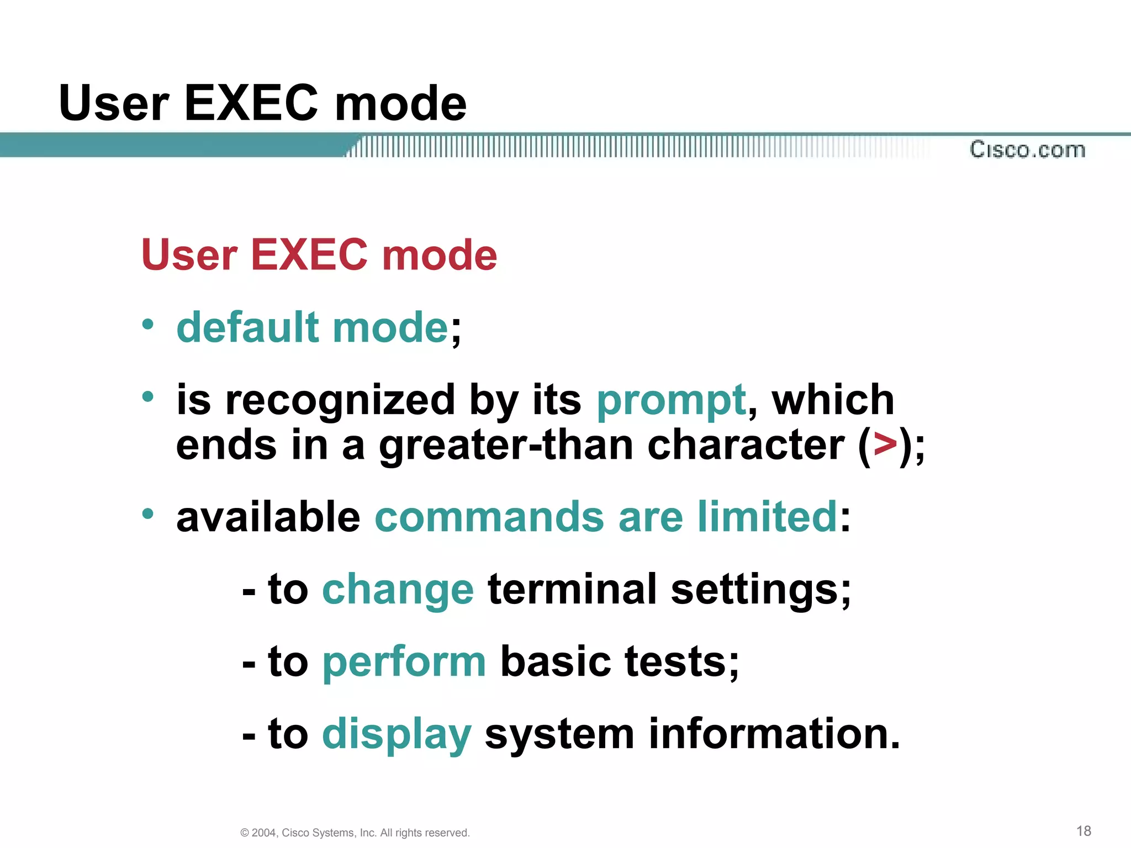
User EXEC mode

Slide 9
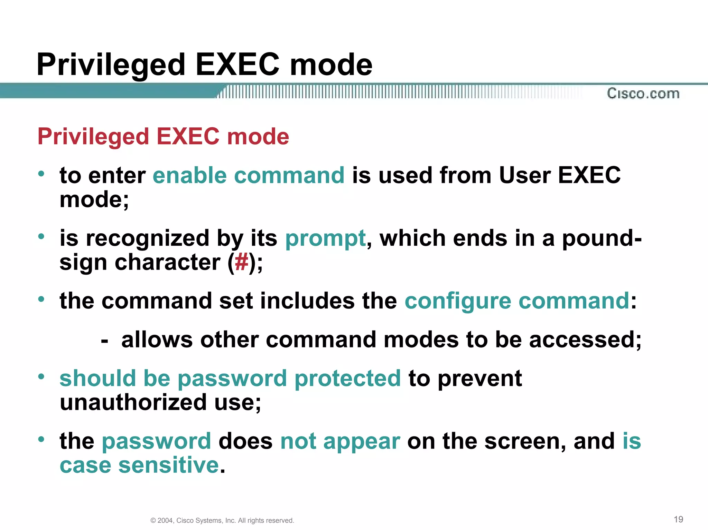
Privileged Exec mode

Slide 10
User exec mode allows basic operations like viewing system information, while privileged exec mode enables configuration changes and access to all commands in a network switch.

Slide 11
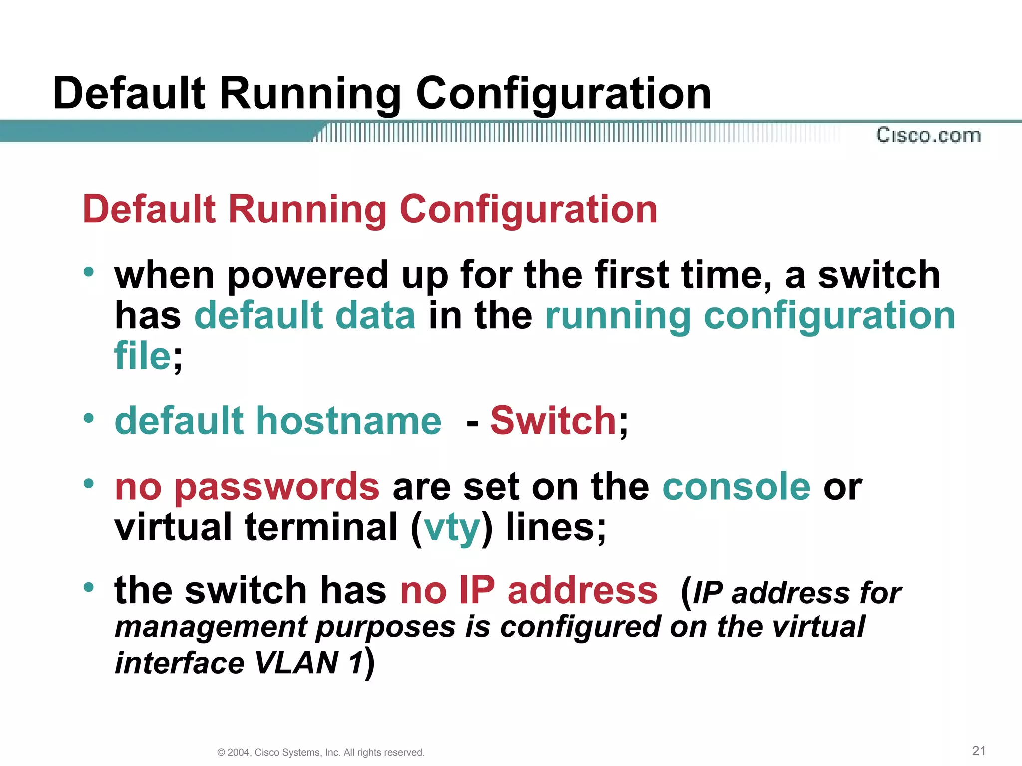
Default running configuration

Slide 12
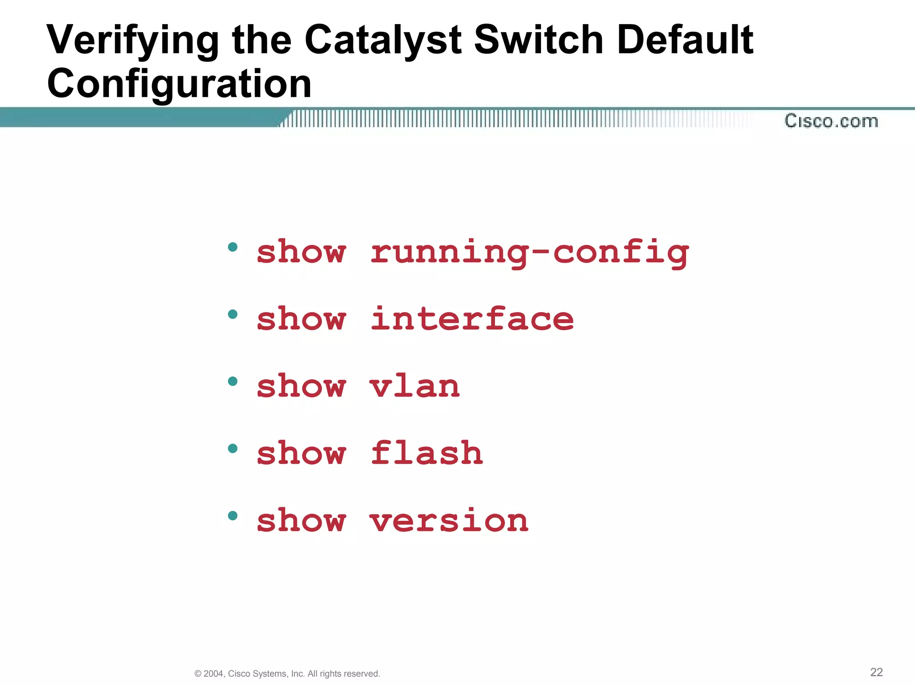

Slide 13
The "show running-config" command displays the current configuration of a network device, including active settings and parameters.
The "show interface" command provides detailed information about the status and configuration of network interfaces on a device, including traffic statistics, error counts, and interface settings.
The "show vlan" command is used to display information about VLAN (Virtual Local Area Network) configurations on a network switch. It shows which VLANs exist, their assigned ports, and their associated VLAN IDs.

Slide 14
The "show flash" command is used to display information about the contents of the flash memory on a network device, such as a router or a switch. It provides details about the files stored in flash memory, including their names, sizes, and types.
The "show version" command provides essential information about the hardware, software, and configuration of a network device, such as a router or a switch. It typically includes details like the device model, firmware version, system uptime, hardware serial numbers, and licensing information.

Slide 15
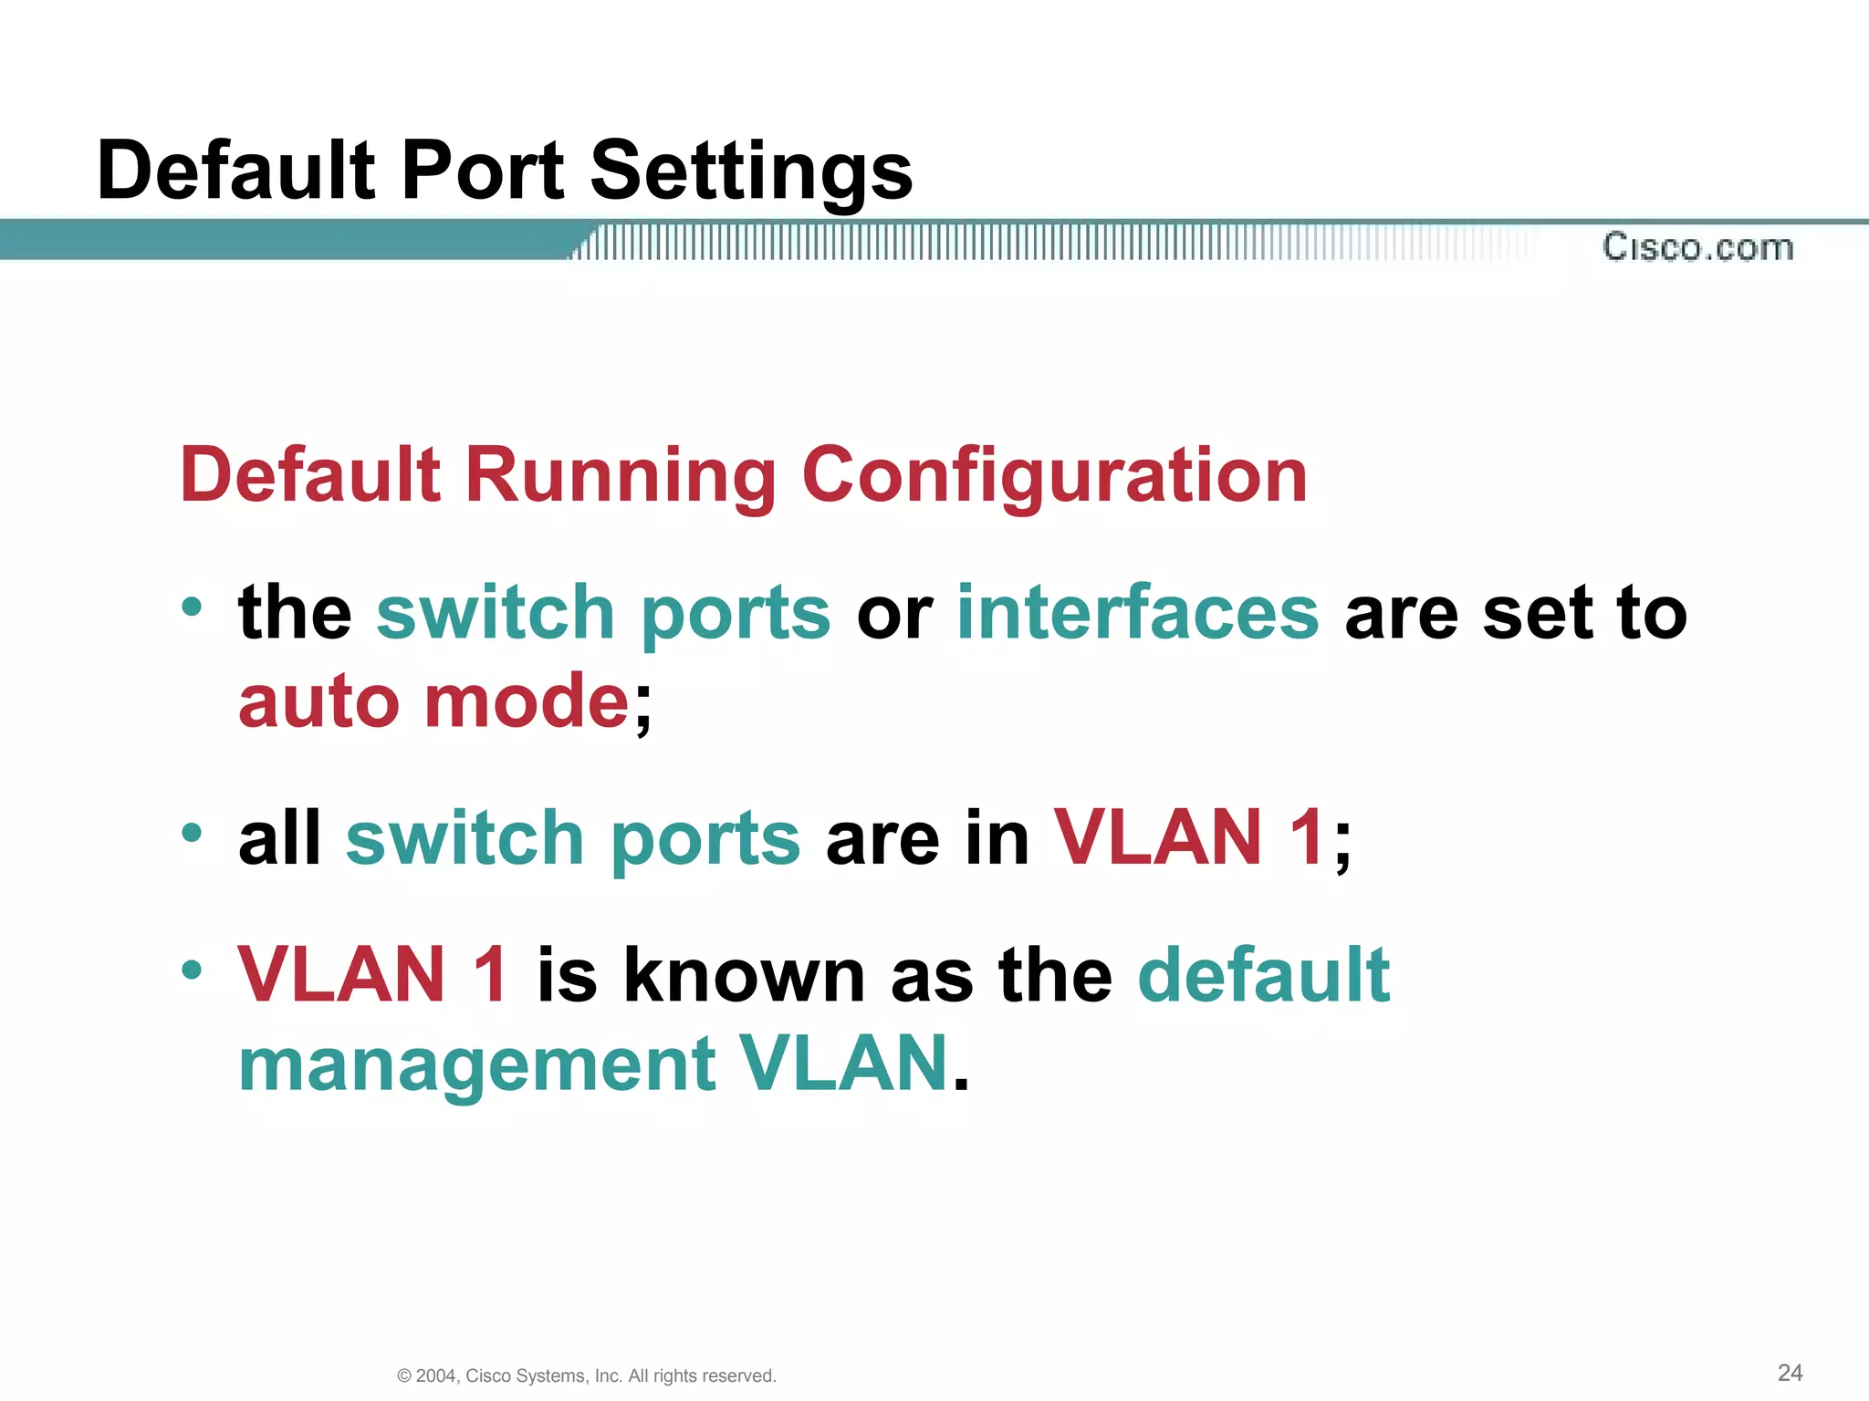

Slide 16
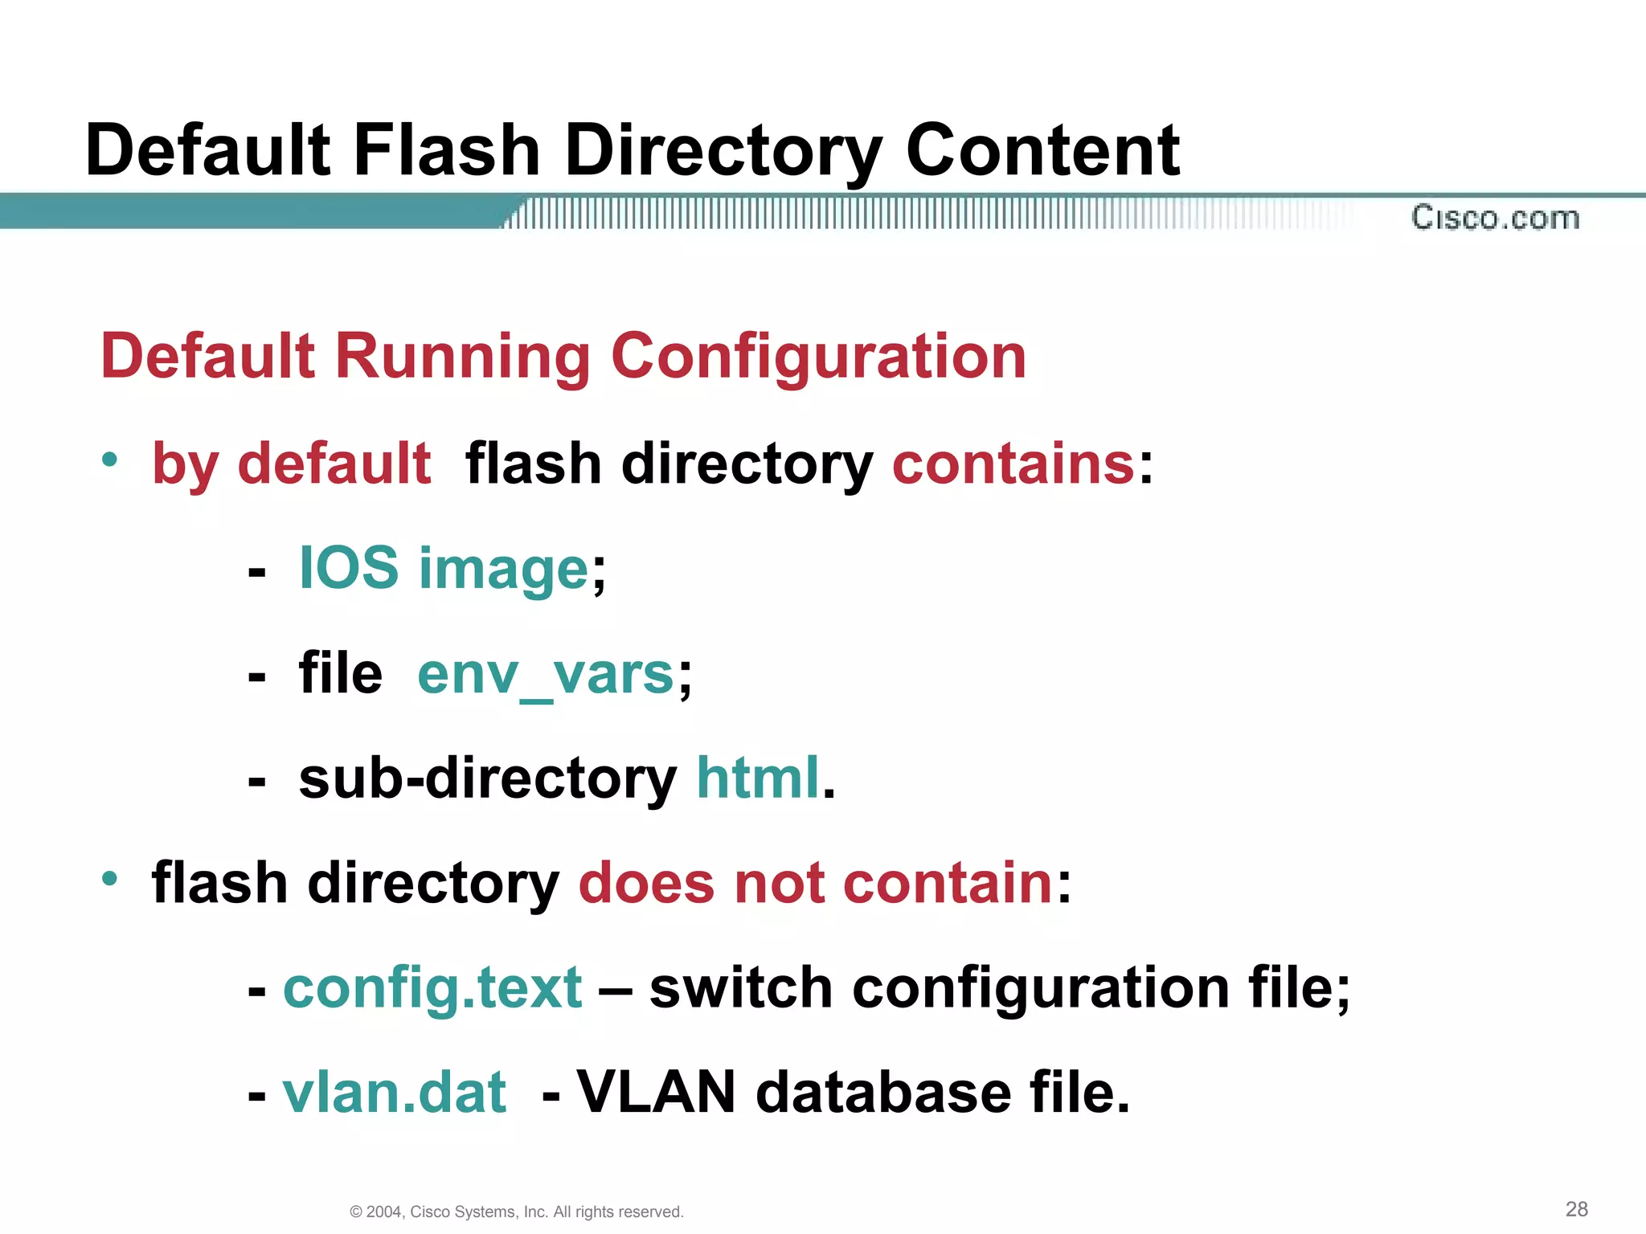

Slide 17
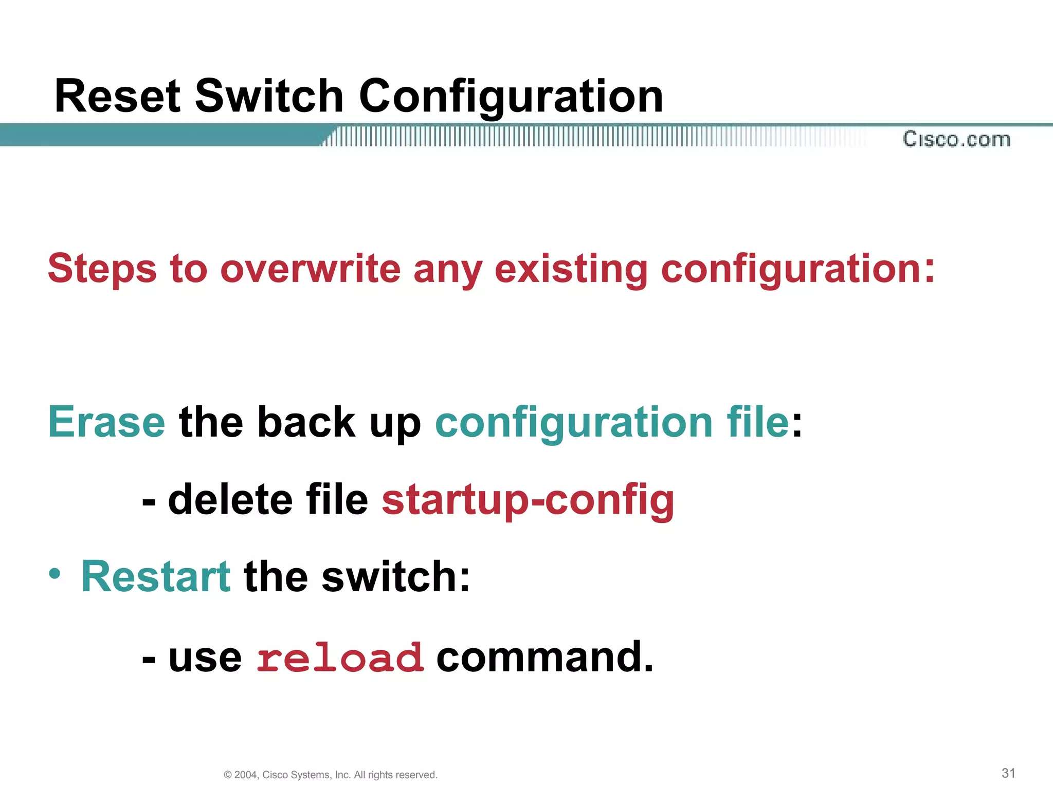
Reset switch configuration

Slide 18
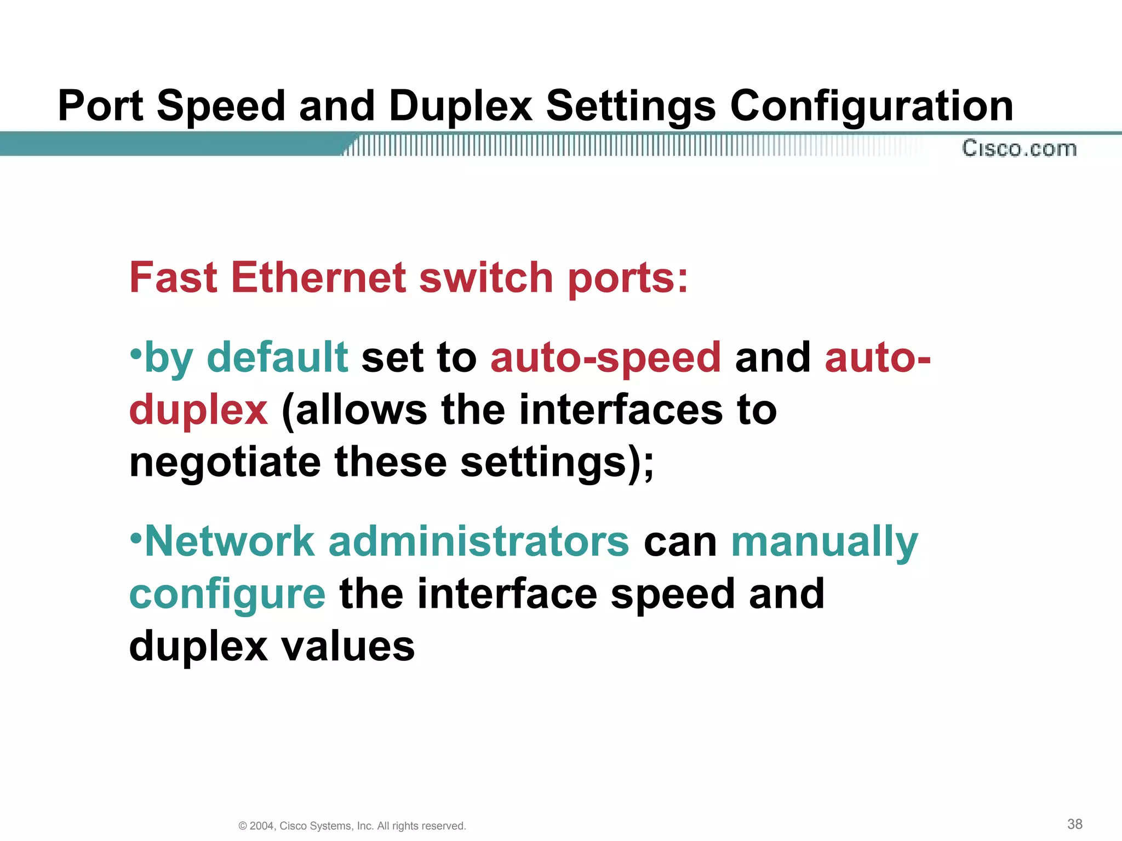

Slide 19
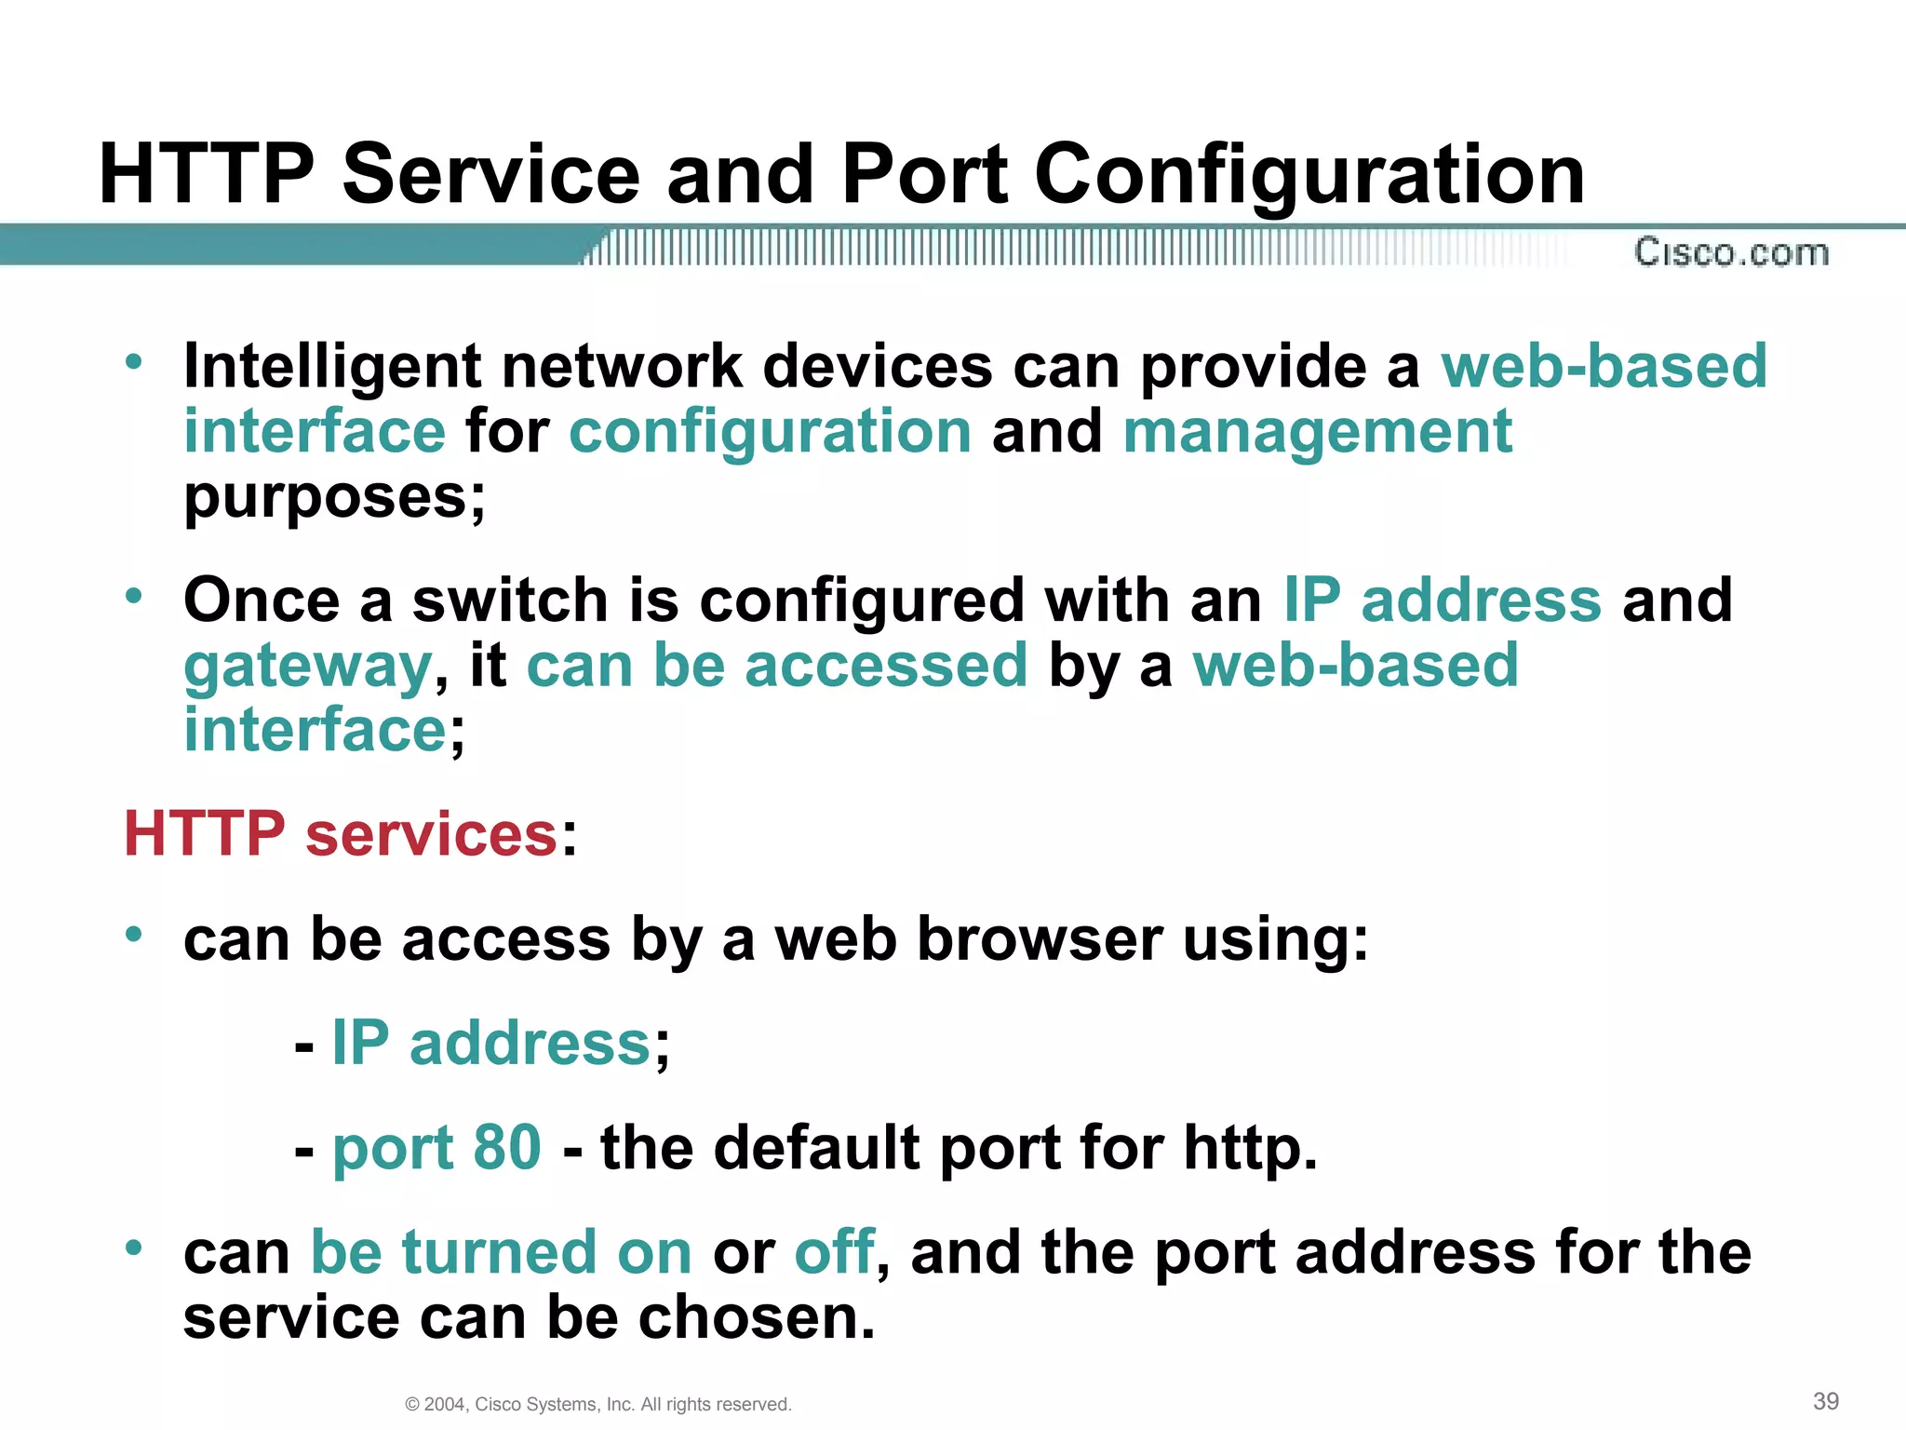

Slide 20
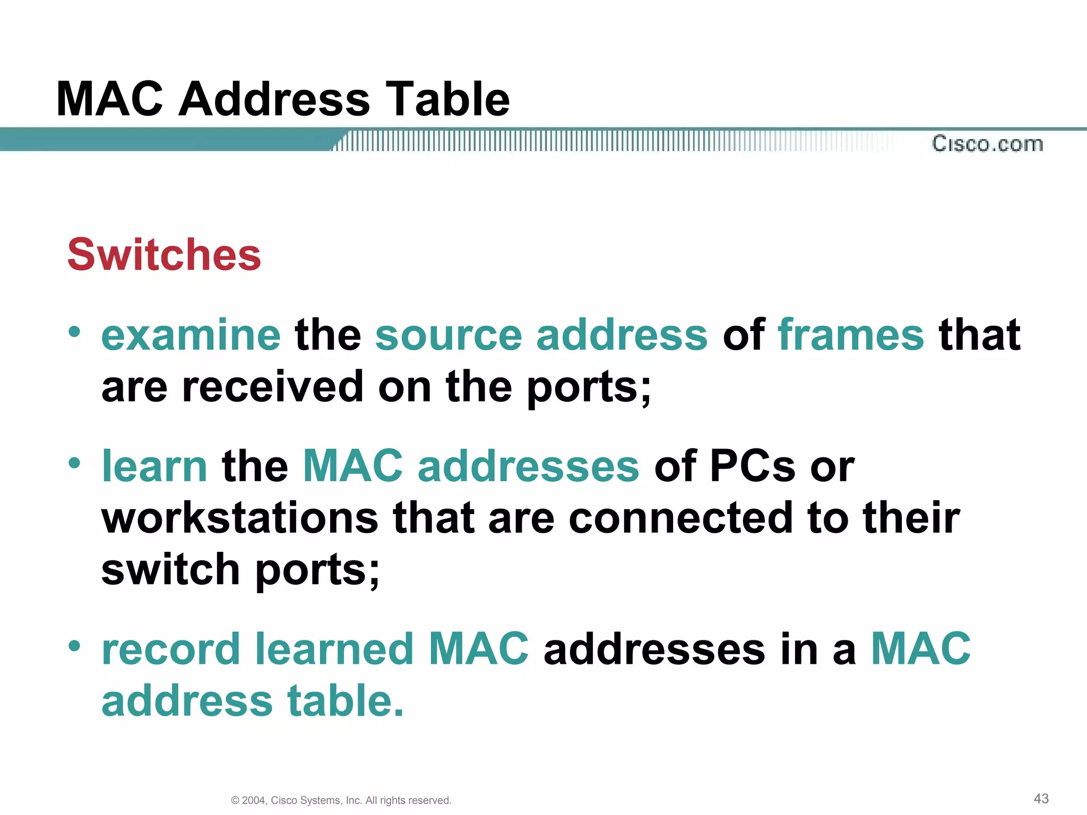

Slide 21
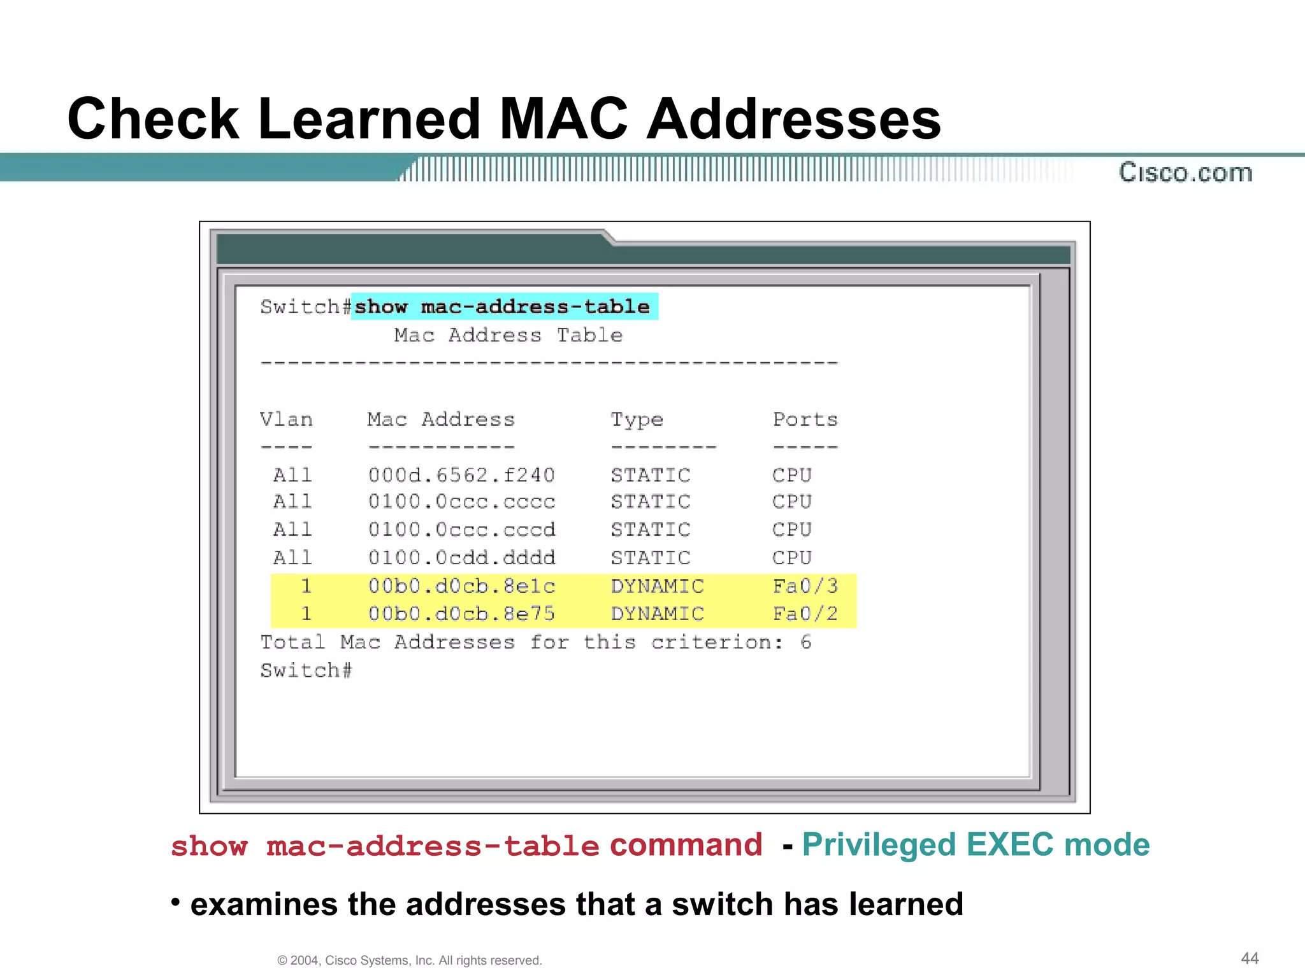

Slide 22
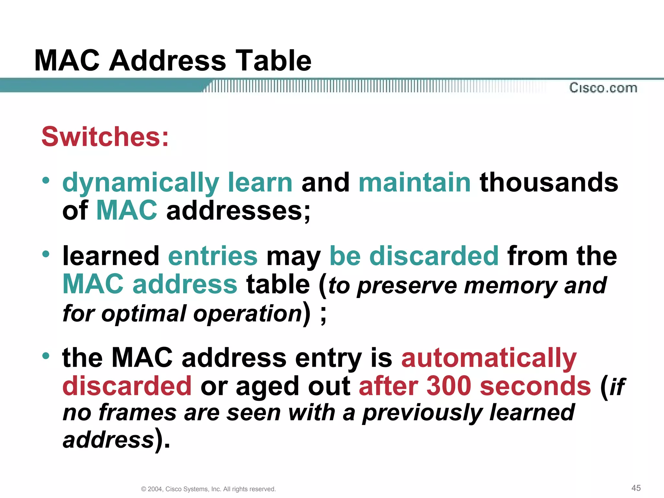

Slide 23
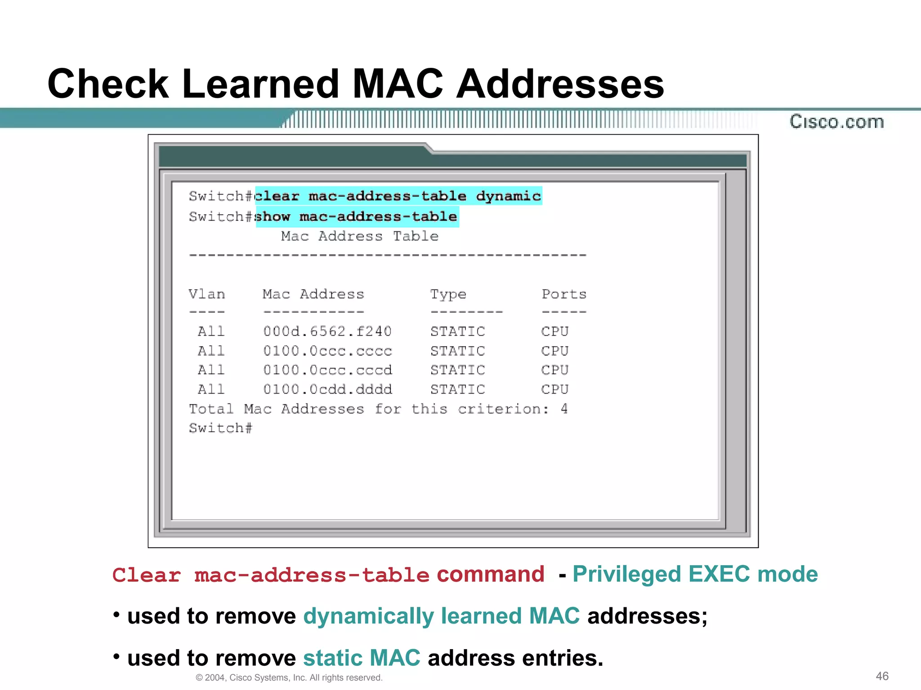

Slide 24
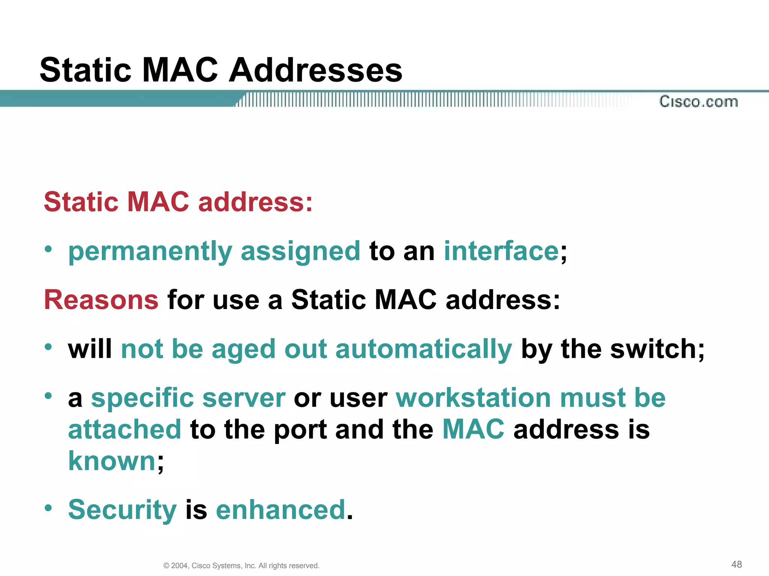

Slide 25
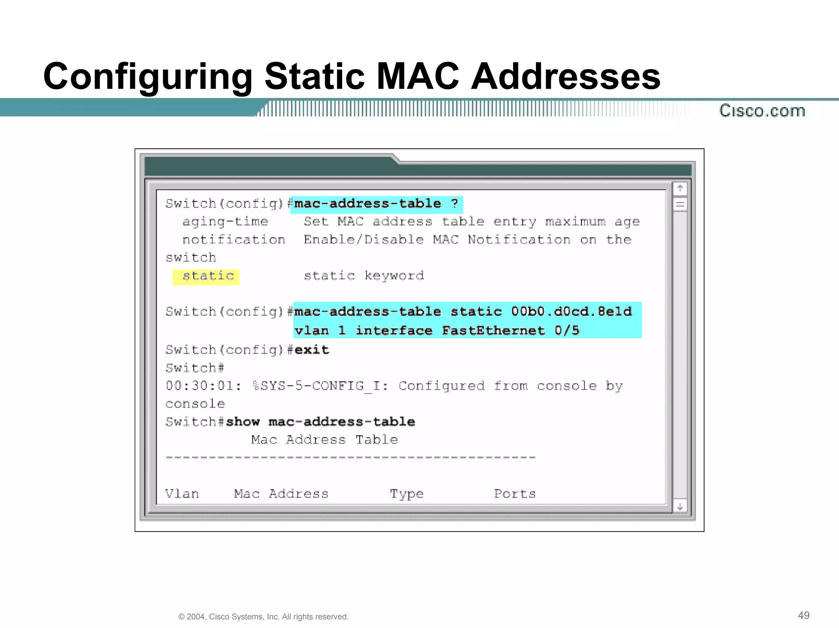

Slide 26
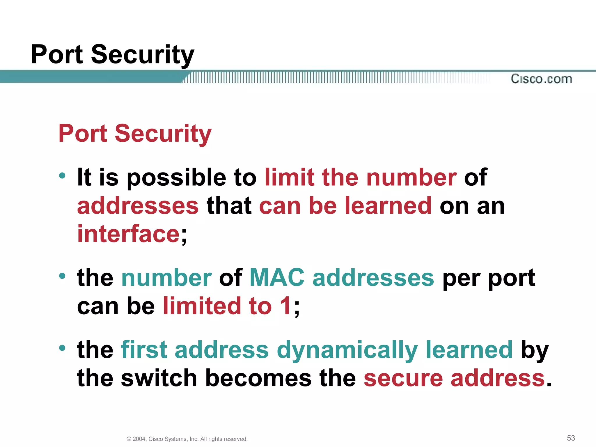
Port Security

Slide 27
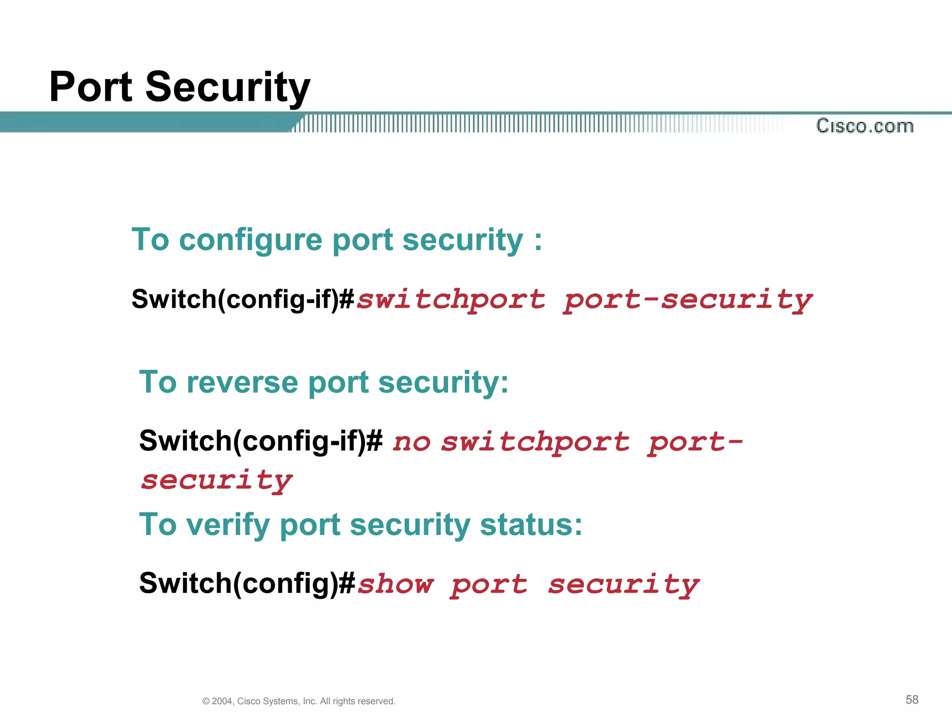

Slide 28
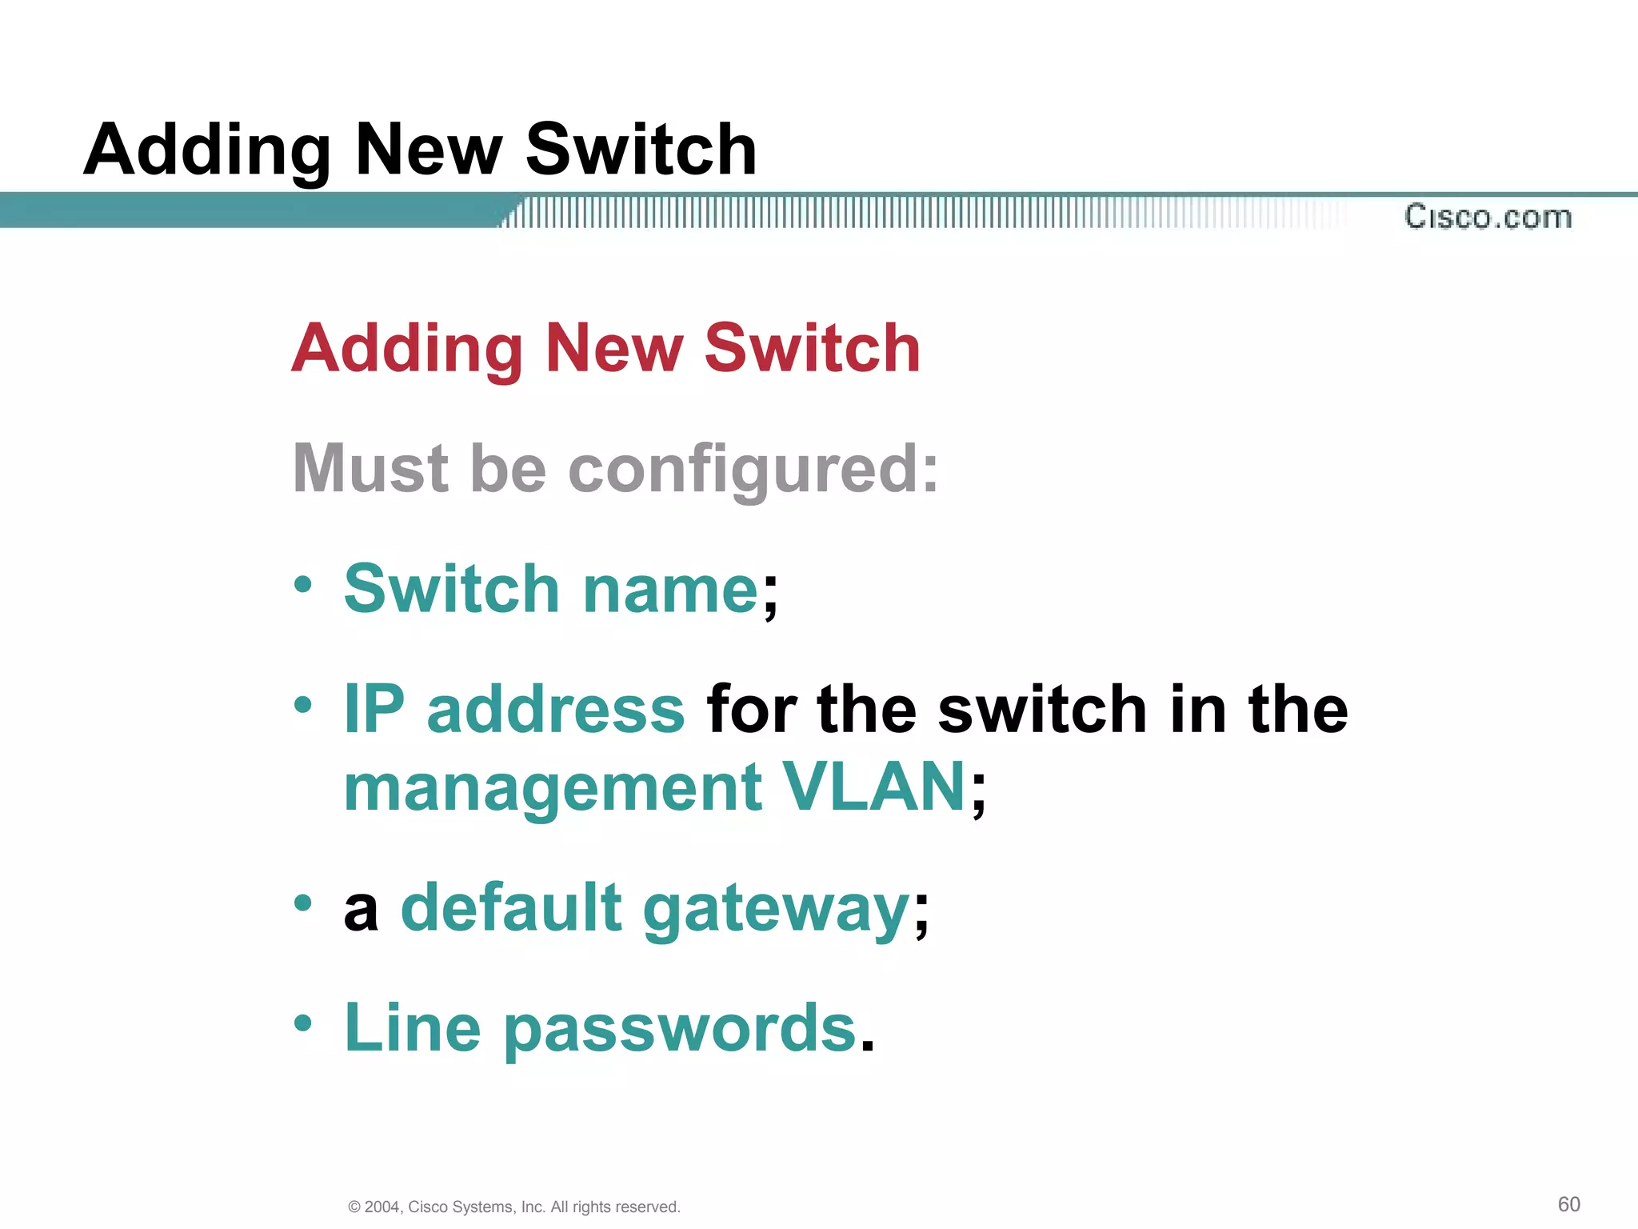
Adding & moving switches to the network

Slide 29
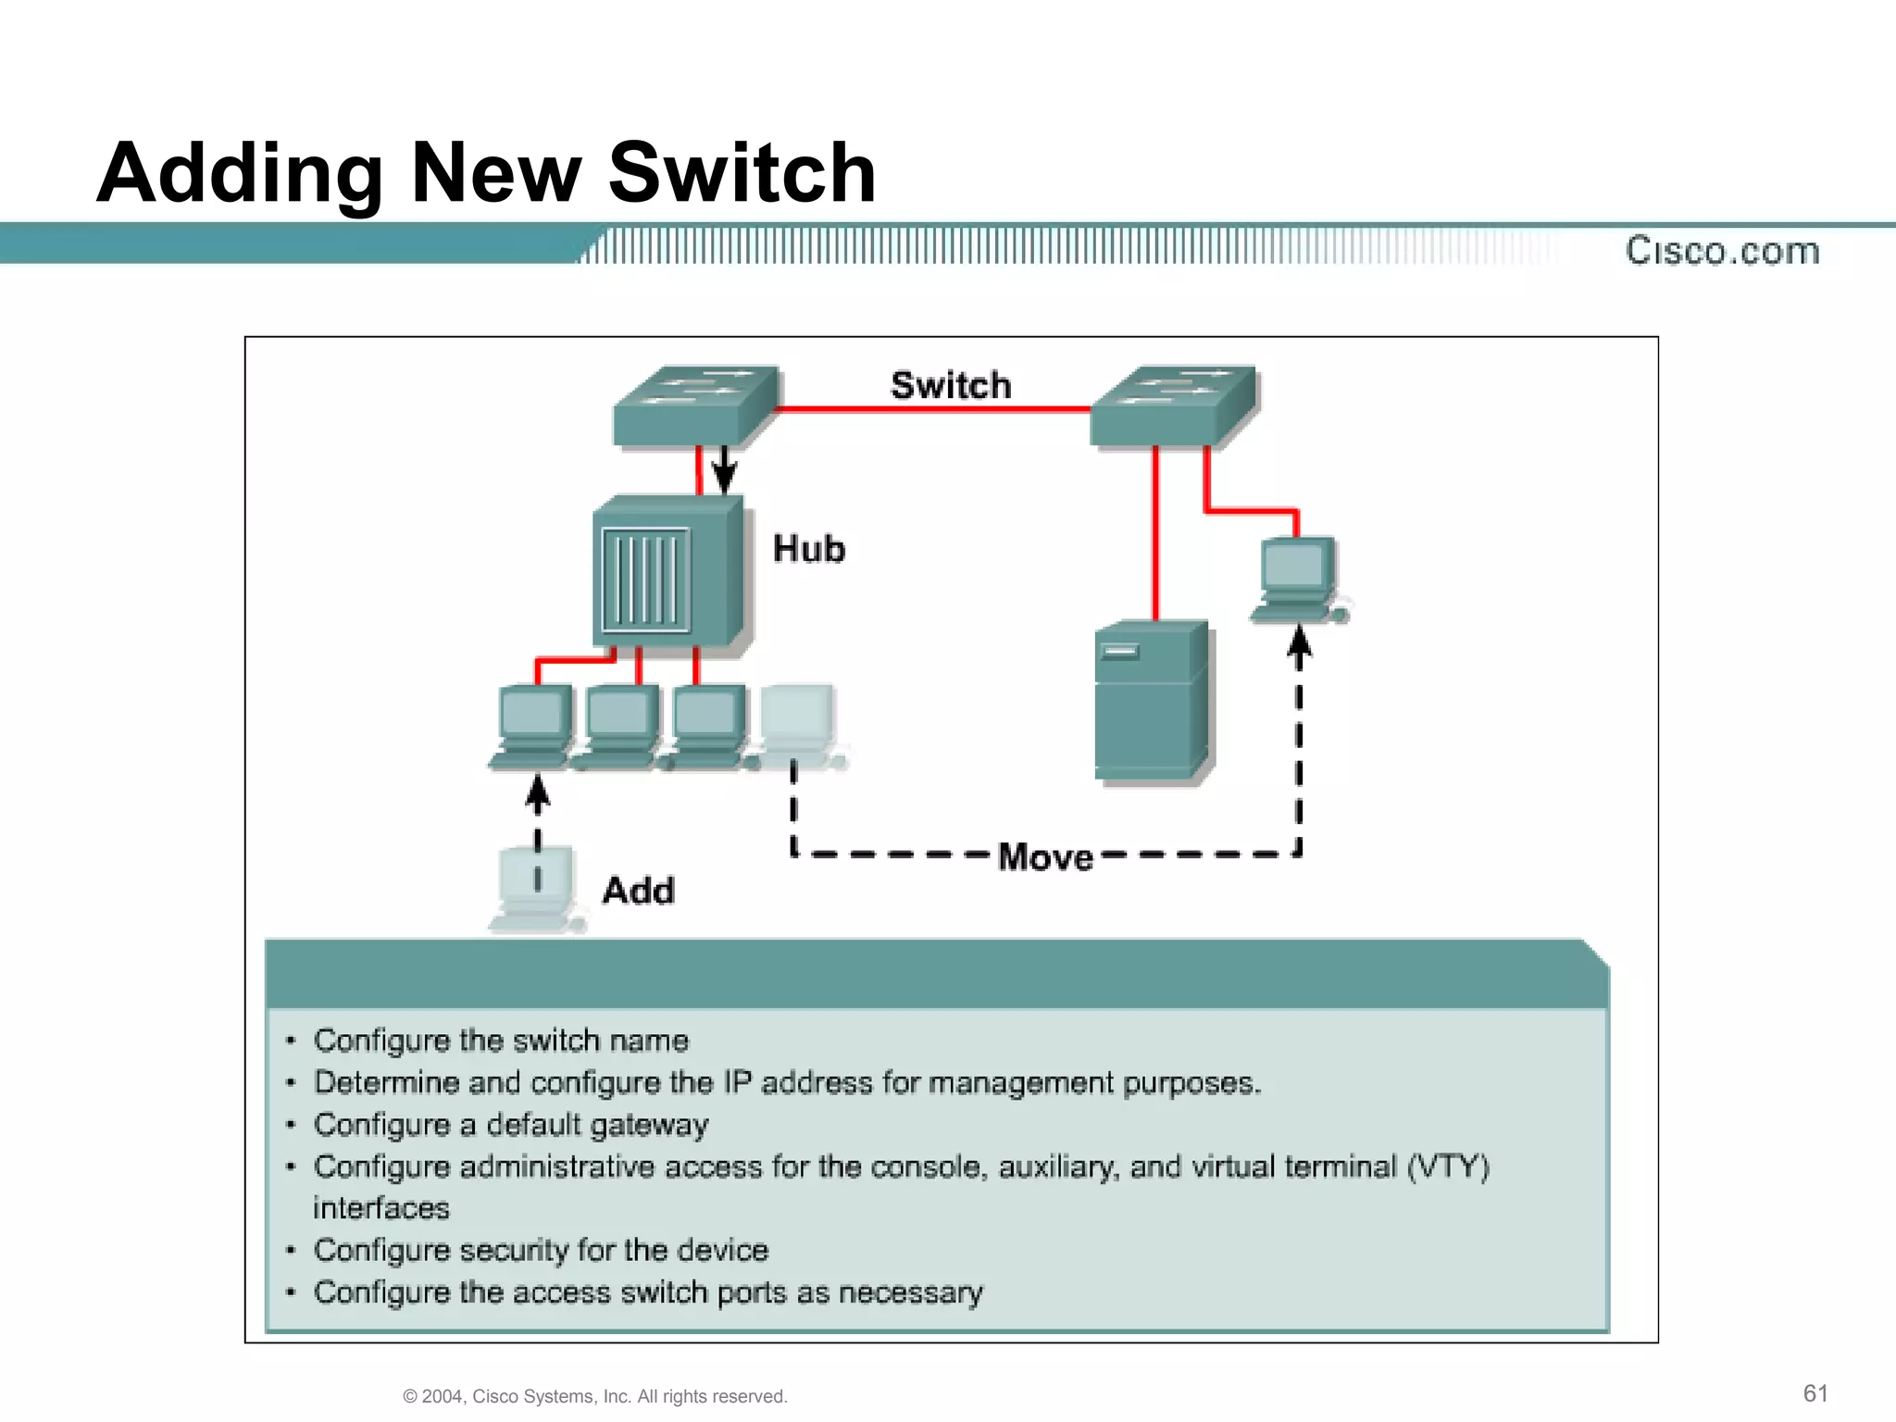

Slide 30
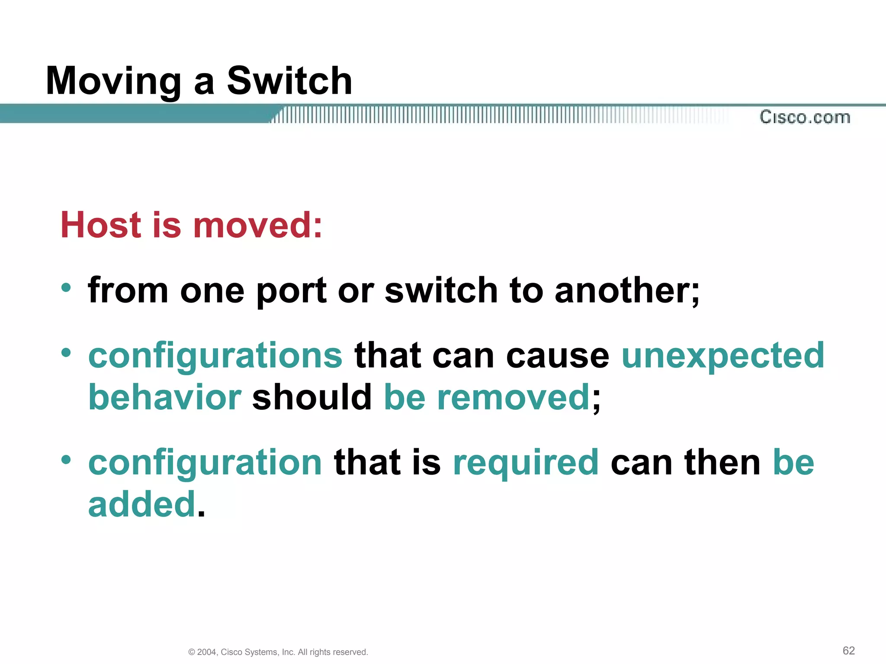

Slide 31
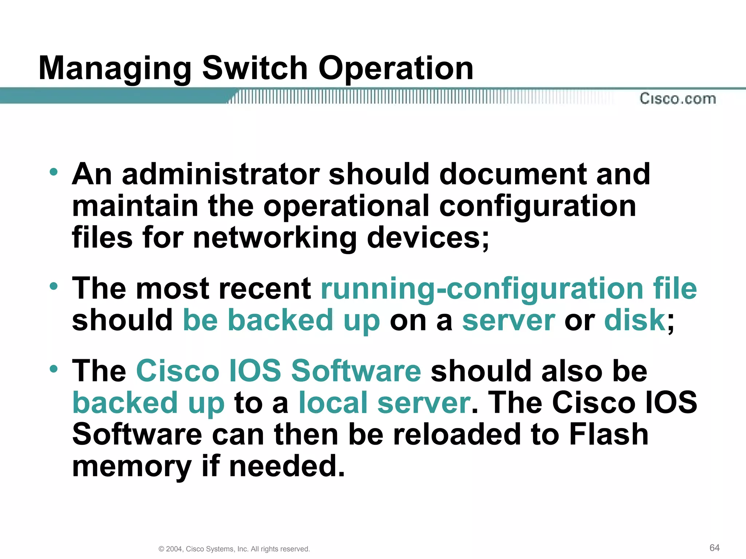
Managing switch operation

Slide 32
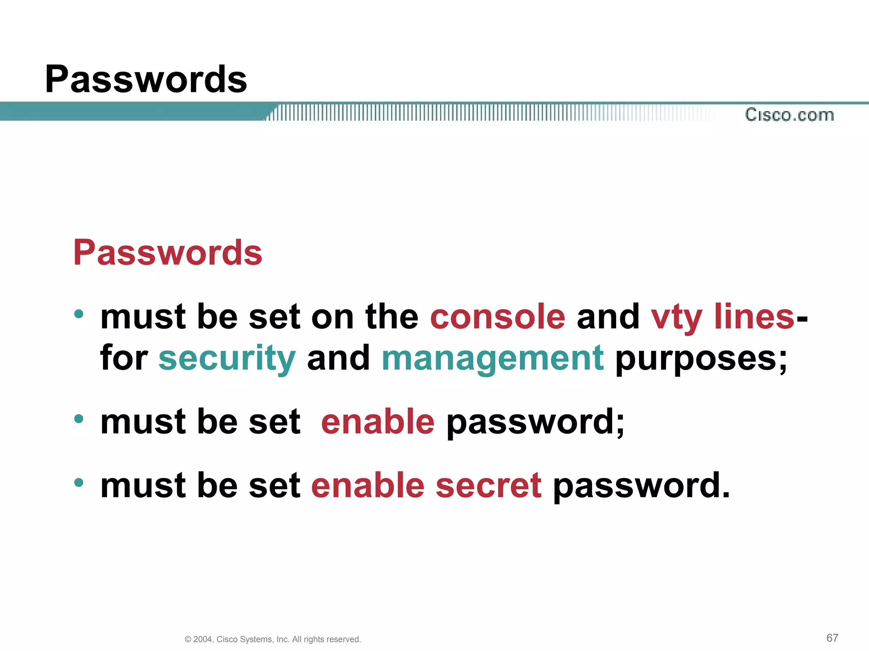
Password Recovery

Slide 33
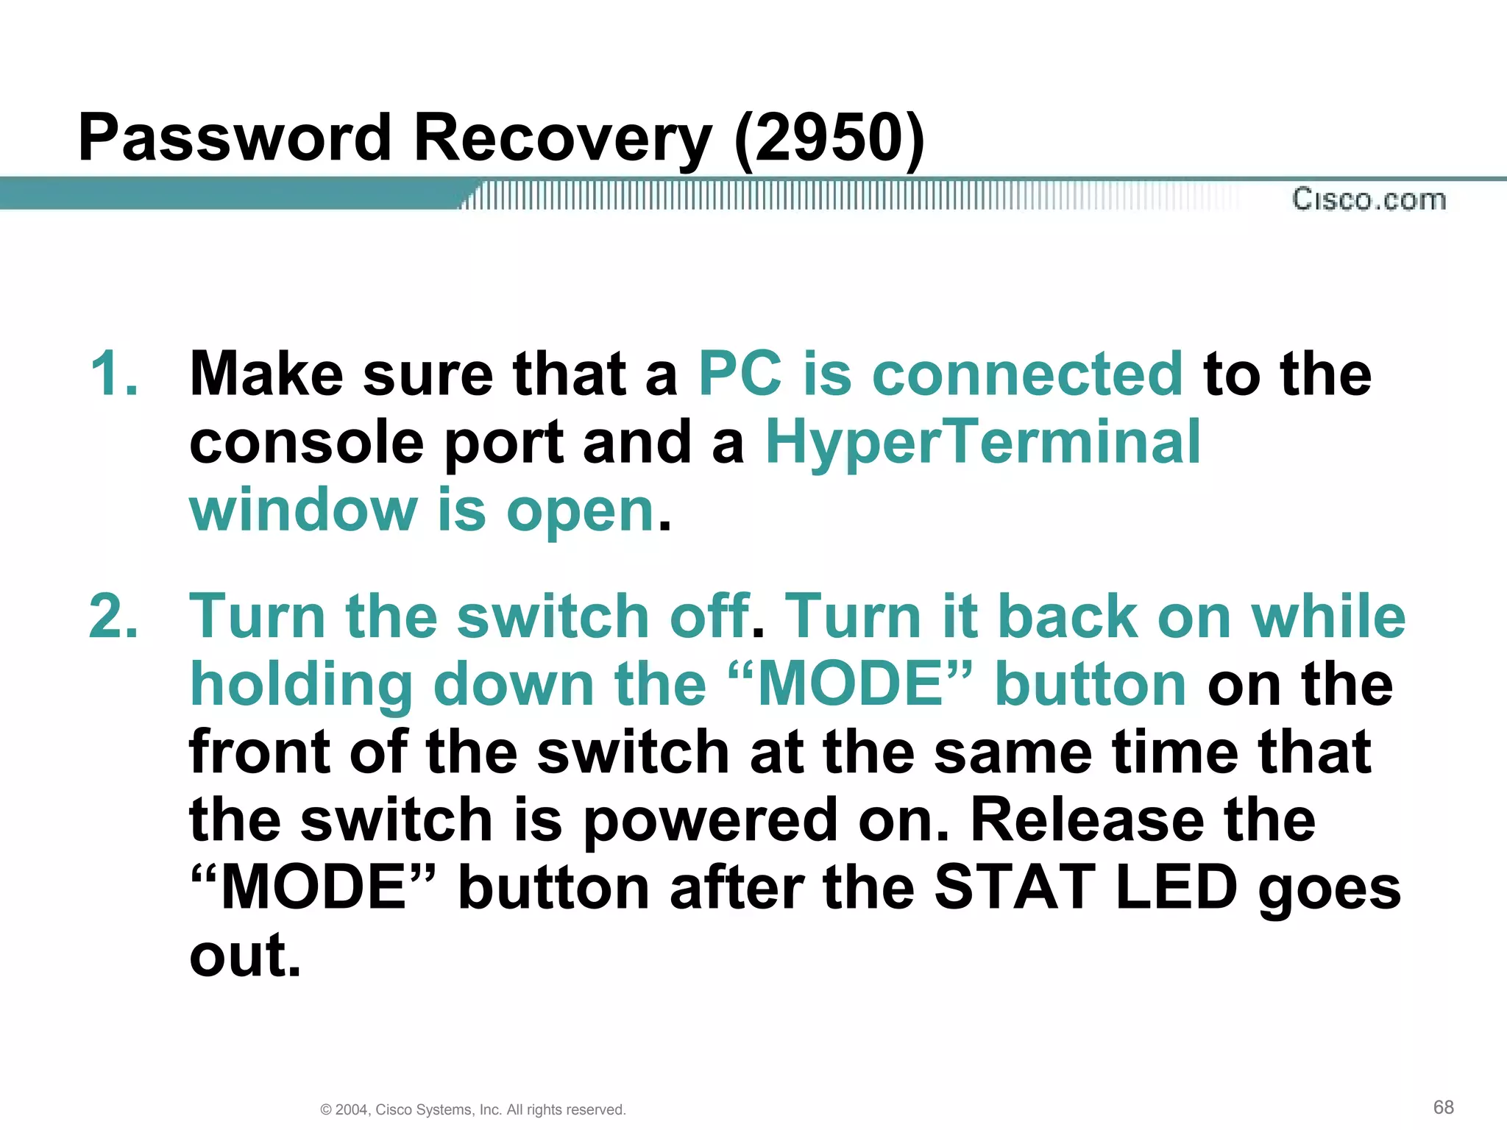

Slide 34
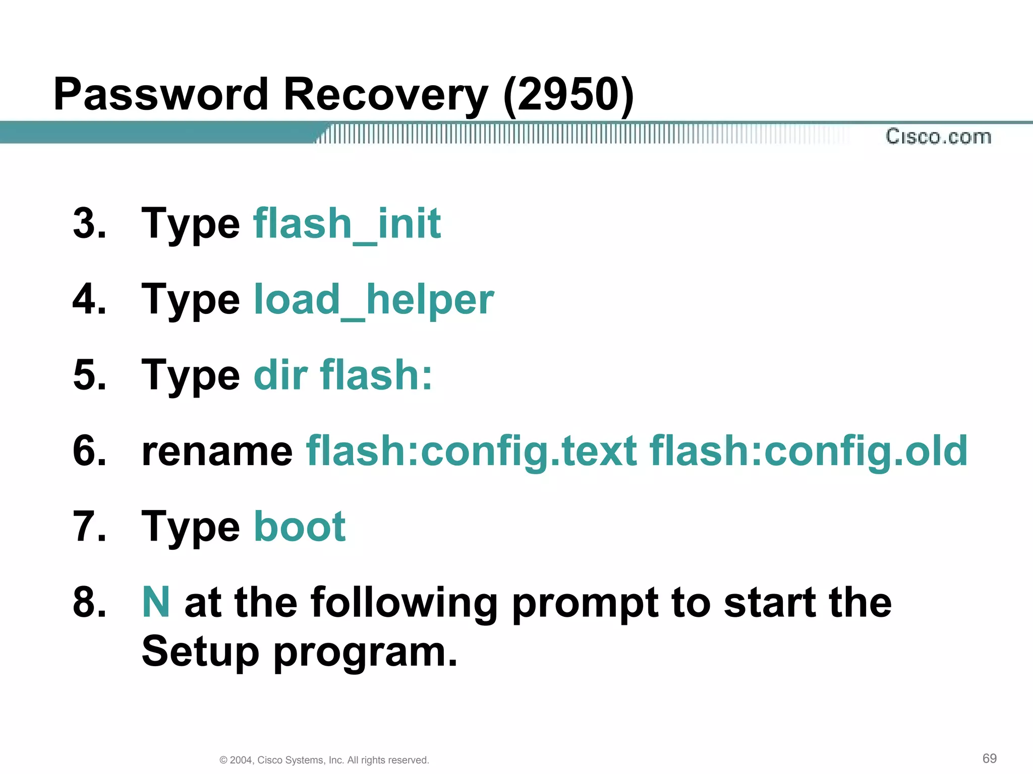

Slide 35
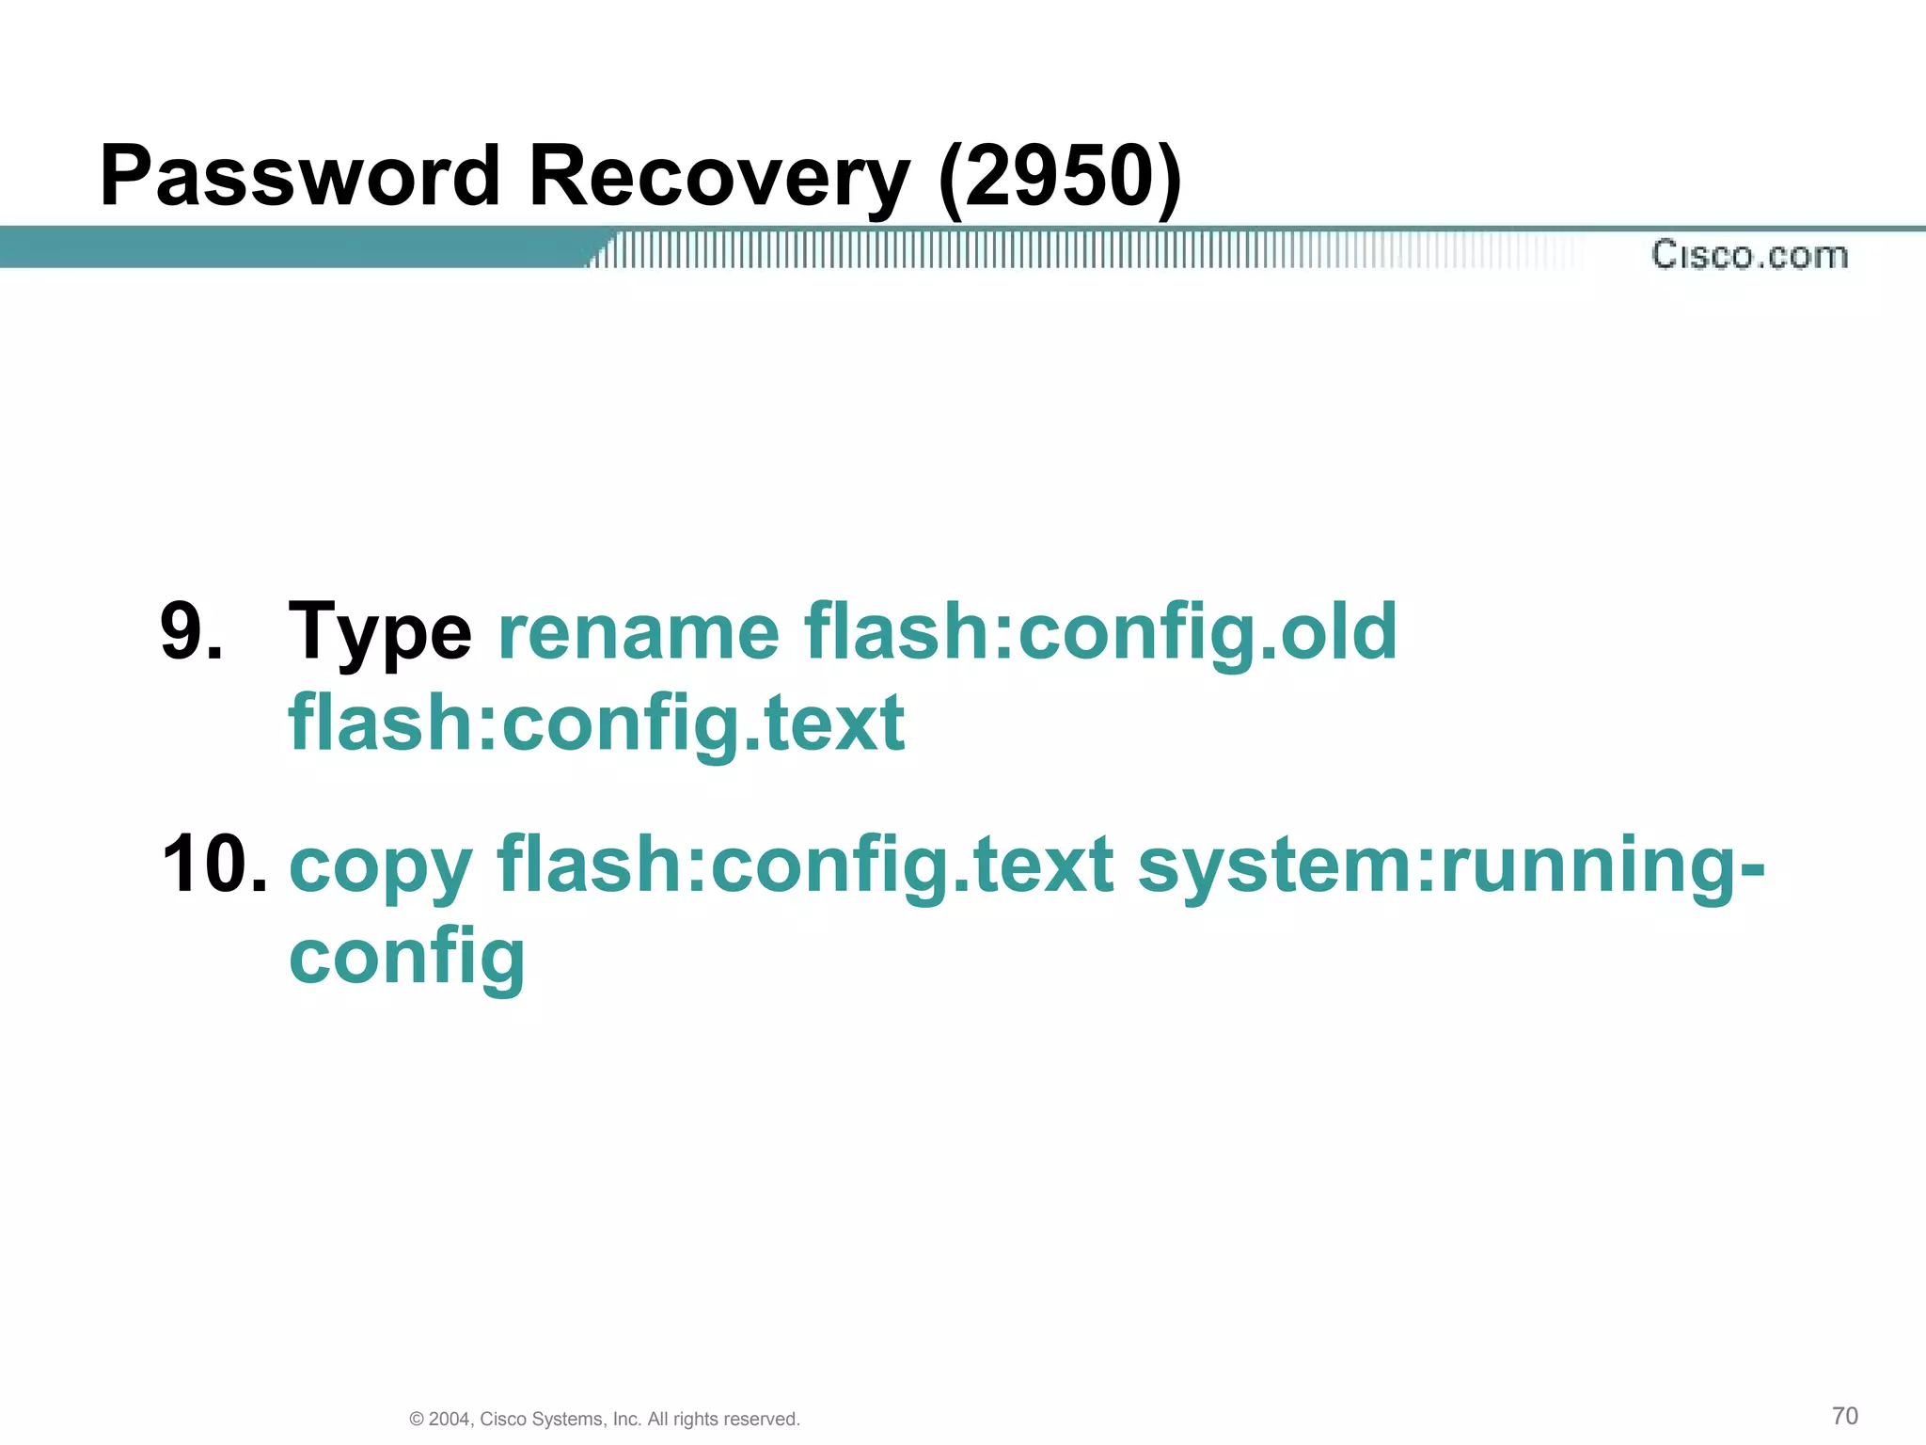

Slide 36
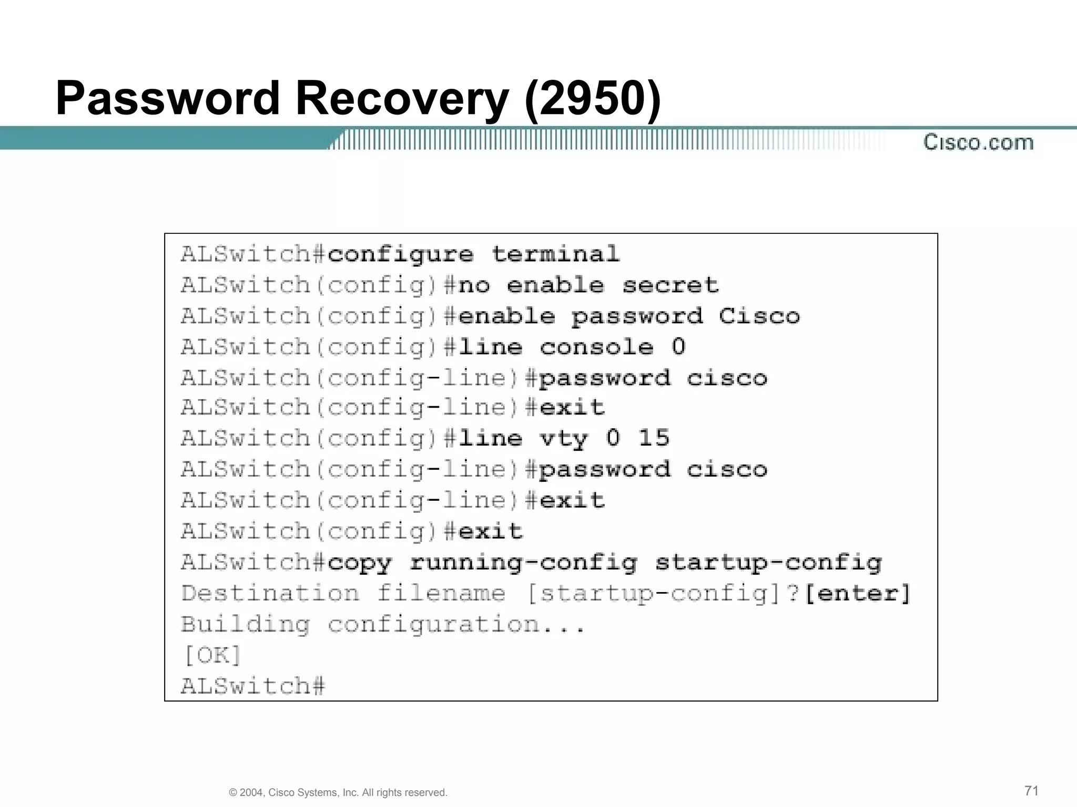

Slide 37
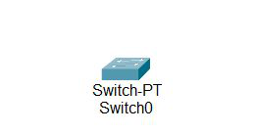
Basic Switch Configuration in Cisco
Steps to Configure the Switch:
Step 1. Open the packet tracer desktop and take a switch (PT-Switch) from the devices.

Slide 38
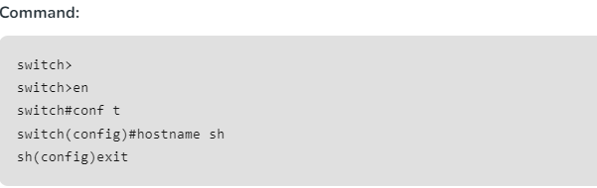
Step 2: Configure the Host name of the swicth0.
Click on switch0 and go to Command Line Interface.
Then change the hostname to “sh”

Slide 39
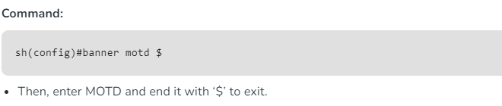
Step 3:
Set a message of the day (MOTD) banner for the users.

Slide 40
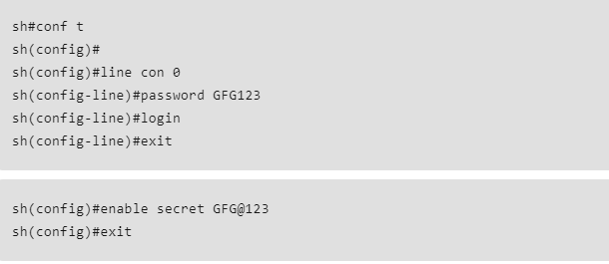
Step 4: Set up line control password and enable secret password.
To configure the Line Control password and Enable secret follow the below commands:

Slide 41
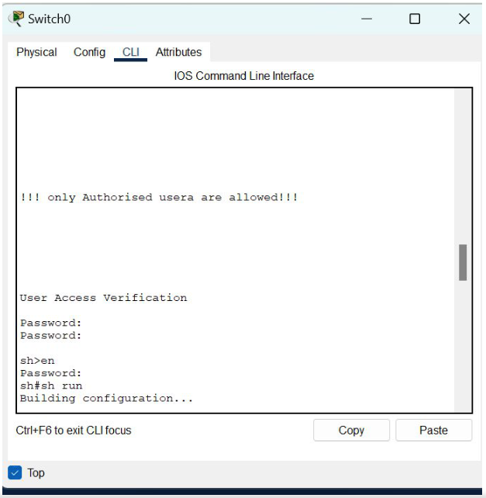
Step 5: Verify the password
When you try to log in first, it will ask for the line control password.
Then, to configure the terminal it will ask to enable a secret password.
To save the c
onfiguration use the below command:

